Slide 1

Employee Data Analysis
Derek Rogers

Slide 2


Agenda
About the Dataset
Employee Turnover
Salary Prediction
job Role Specific Trends

Slide 3

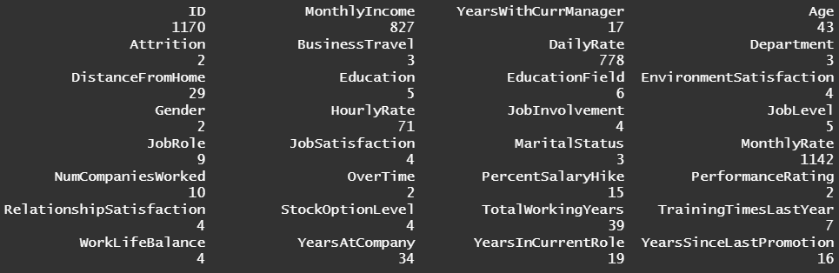
About the Data

Slide 4

Employee Turnover

Slide 5
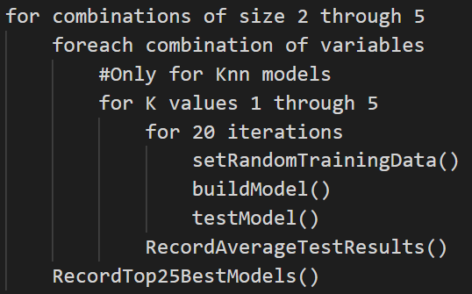
Methodology
Used an equal number of rows with yes and no attrition values for training the model
Ran every combination of variables for both Knn and Naïve Bayes up to combinations of 5
Took the top 25 performing models for each combination size and counted the number of times each variable appeared
Ran 20 iterations with different training values

Slide 6
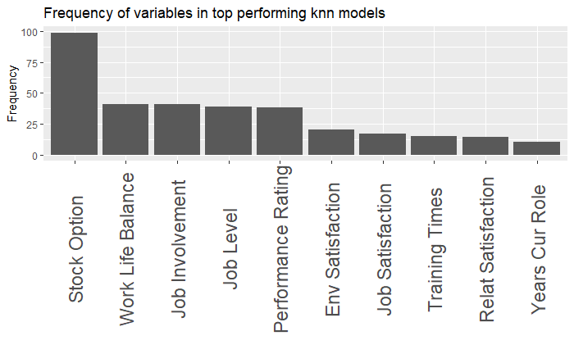
Key factors in employee turnover for Knn model
Stock option
Work life balance
Job Involvement
Job Level
Performance Rating

Slide 7
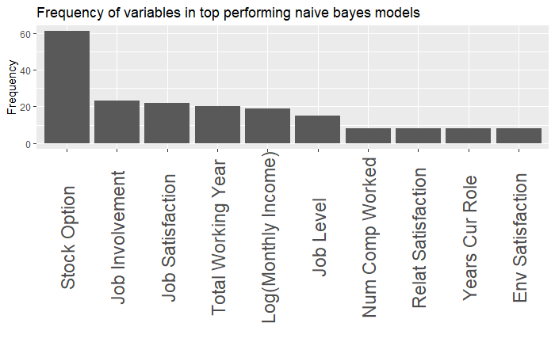
Key factors in employee turnover for Naïve Bayes model
Stock option
Job Involvement
Job Satisfaction
Total Working Years

Slide 8
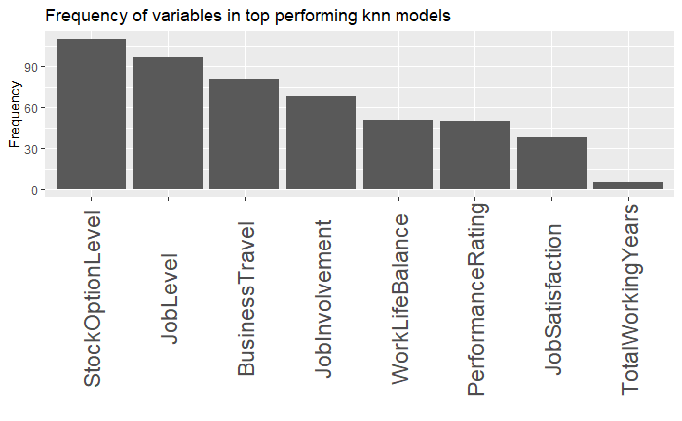
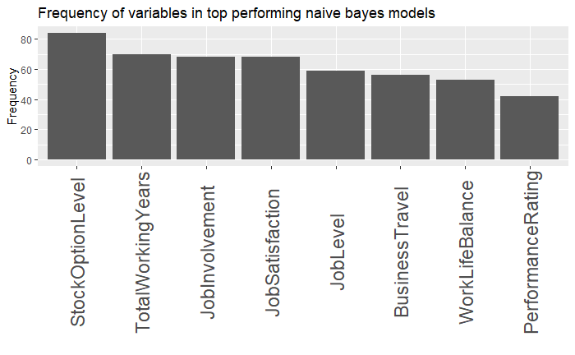
Round 2 of testing
Kept top performing variables from both Knn and Naïve Bayes models and added in business travel
Reran previously used tests but with focused subset of variables

Slide 9

Top attributes for attrition
Stock Option
Job Involvement
Job Level
Business Travel
Work Life Balance

Slide 10

Salary Prediction

Slide 11
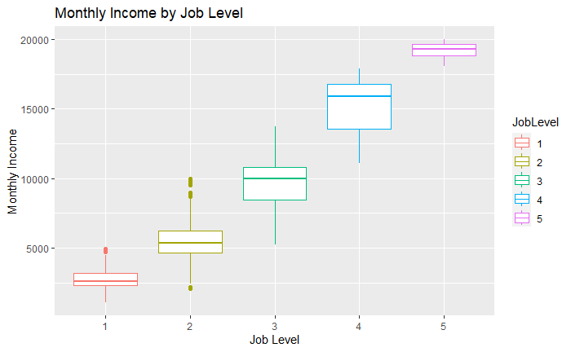
Predicting Monthly Income By Job Level
Strong correlation between Job level and monthly income
It is estimated that 87.5% of the variation in the data can be explained by the group membership of job level

Slide 12

Job Role Trends

Slide 13
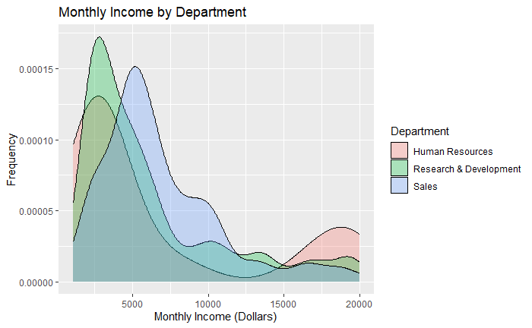
All departments show a right skew in distribution
Human resources shows the lowest frequency in middle incomes but highest frequency of high incomes
Sales has the least skewed distribution
Research & Development have the highest frequency of low monthly income

Slide 14
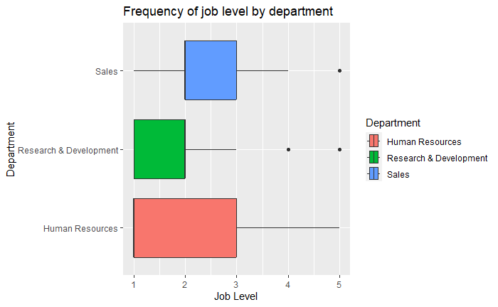
Explains the distribution of incomes for the various departments in the previous slide can be explained by the distribution of the job levels for each department
Sales has the highest frequency of middle job levels which explains the high frequency of middle monthly incomes
Research & Development has the highest frequency of low job level employees which explains the high frequency of low monthly income

Slide 15
Thank you
Derekgrogers1@gmail.com
https://dotsumwedge.github.io/

